Slide 1




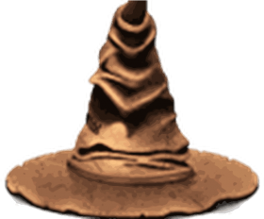


Sorting Algorithms
By Ben Royans [P205225]

Slide 2
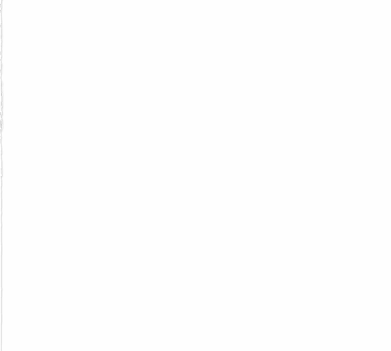

Sorting Algorithms used in this project:
Merge Sort
Heapsort
Shellsort
Quicksort
Bubble Sort
Quantum Bogo Sort

Slide 3
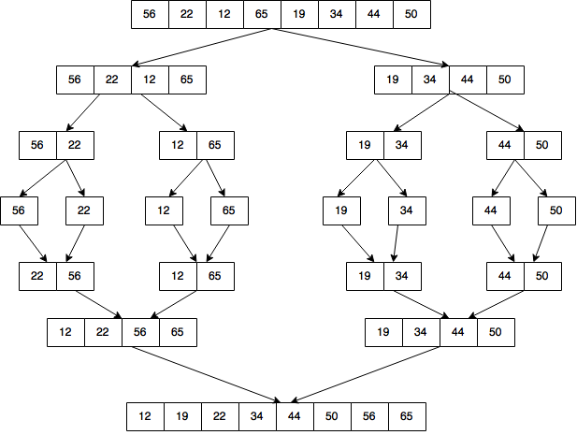
Merge Sort
Advantages
Fast, efficient method.
Disadvantages
Requires extra storage, not an in-place algorithm.
Time Complexity
Best | Average | Worst
Ω(n log(n)) | Θ(n log(n)) | O(n log(n))

Slide 4
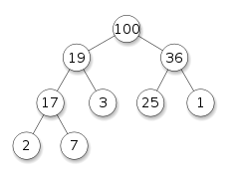
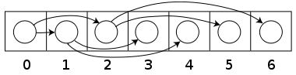
Heapsort
Advantages
Fast, efficient method.
Disadvantages
An unstable sort which may re-arrange the original order.
Time Complexity
Best | Average | Worst
Ω(n log(n)) | Θ(n log(n)) | O(n log(n))

Slide 5
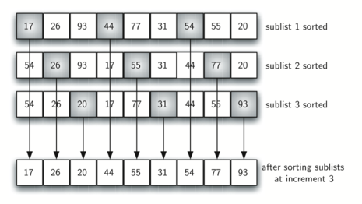
Shellsort
Advantages
Simple algorithm that can be implemented on smaller scales where speed is not a critical factor.
Disadvantages
Not as efficient as Merge, Heap or Quick sorts in its methodology.
Time Complexity
Best | Average | Worst
Ω(n log(n)) | Θ(n(log(n))^2) | O(n(log(n))^2)

Slide 6
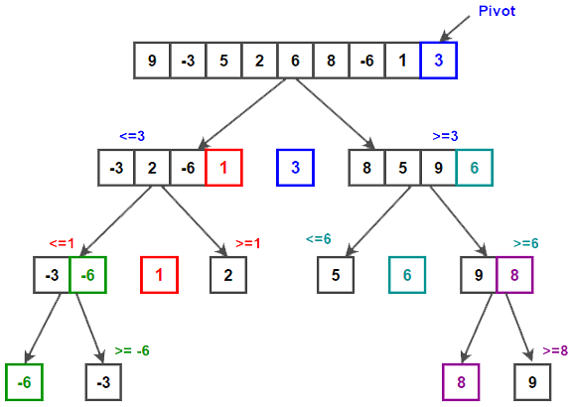
Quicksort
Advantages
‘In-place’ method not requiring extra space to deconstruct elements.
Disadvantages
Unstable algorithm.
Worst case scenario is O(n^2) when poor pivot points have been selected.
Time Complexity
Best | Average | Worst
Ω(n log(n)) | Θ(n log(n)) | O(n log(n))

Slide 7
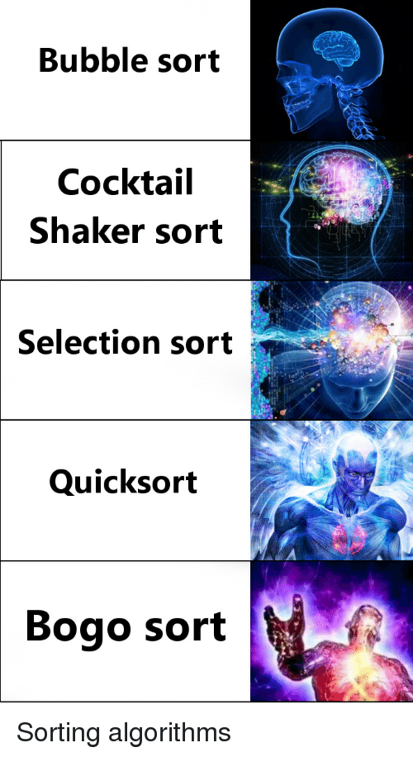
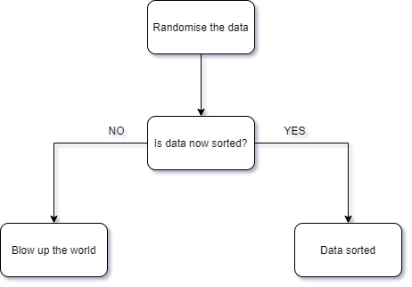
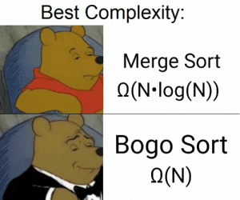

Quantum Bogo Sort
Advantages
Disadvantages
Limited re-usability
Potentially disastrous consequences
Time Complexity
Best | Average | Worst
Ω(n) | Ω(n) | Ω(n)

Slide 8
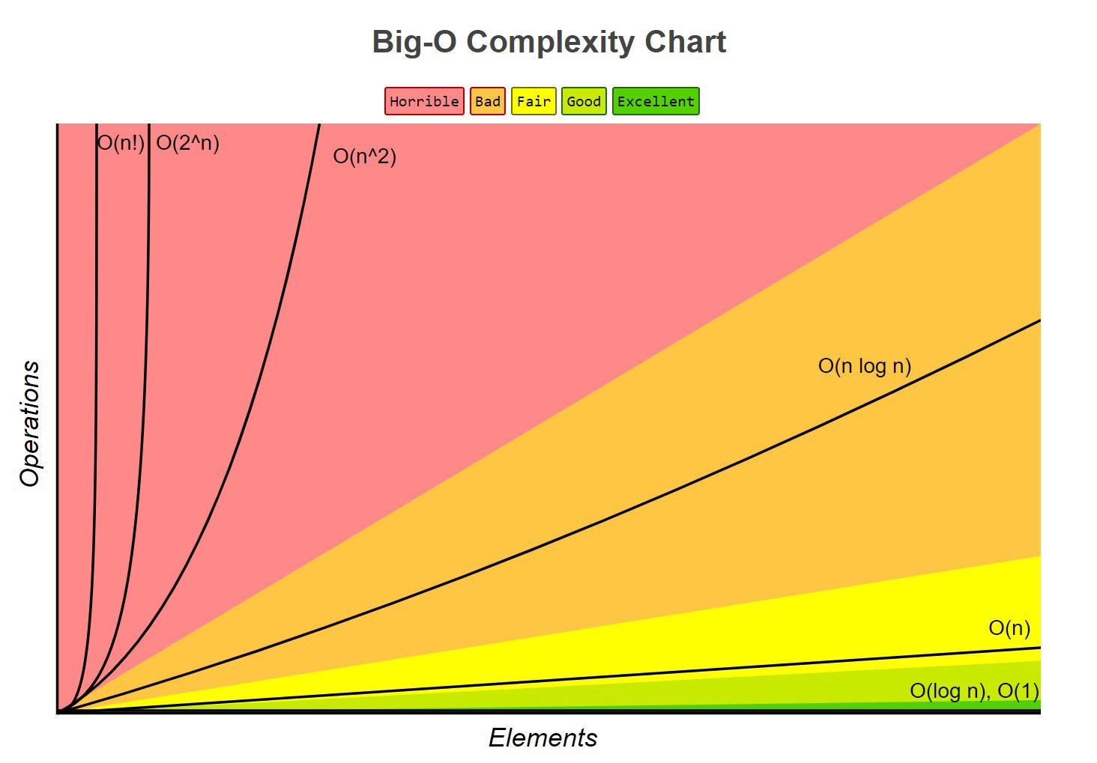

Slide 9
Image References
https://upload.wikimedia.org/wikipedia/commons/1/1b/Sorting_heapsort_anim.gif
https://upload.wikimedia.org/wikipedia/commons/d/d8/Sorting_shellsort_anim.gif
https://www.tutorialspoint.com/data_structures_algorithms/images/quick_sort_partition_animation.gif
https://giphy.com/gifs/algorithm-WLkahNhIBzxJu
https://giphy.com/gifs/earth-HtPQ2DrTFvG1y
https://www.c-sharpcorner.com/blogs/quick-sort-algorithm-in-c-sharp

Slide 10

Thanks for watching
By Ben Royans

